Slide 1
NOVASCOPE SITEMAP
Index
ABOUT US
TECHNOLOGY
PIPELINE
SOLUTIONS
INVESTORS
NEWSROOM
CONTACT US
Mission
Semiconductor DNA
Sepsis
Biochip + Devices
Download
Presentation
Press Releases
IR Contact
PR Contact
Sales Contact
The Company
Alzheimer's Disease
Clinical & Care Settings
Full-Stack Biochemstry
Publications
Milestone
BioFET
Team
Intellectual property
Scientific Advisory Board

Slide 2
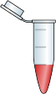







NOVASCOPE End-To-End Solutions: Where Biochemistry Meets Semiconductors
TECHNOLOGY
NovaAssay
NovaCHIP
NovaBIO
Molecule-agnostic
Cost-effective ASIC
Microfluids-based fast-tracked sample
Buffer system
Enabling Engine
Bio-probes
Surface Treatment
NovaLINK
NovaKIT
EG- FET
Patented chemistry
Proprietary reagents
Probe embedded in surface coating
Cartridge for disposable ASIC
Analyzer for data reading
Detection based on the change of the electric charge distribution at the surface of NovaCHIP after the binding with the analyte
Value-added services
NovaAI
NovaCRO
Smart process
Automation
Test Data
Specimen repository
Certified lab

Slide 3
TECHNOLOGY
A New Paradigm for Clinical Diagnostics
Novascope is redefining in-vitro diagnostics (IVD) by uniting two historically separate disciplines: semiconductor engineering and biochemistry. As a BioIC company, we apply the rigor, scalability, and design discipline of CMOS-based integrated circuits to the complexity of biomolecular detection by creating a fully integrated, end-to-end IVD platform.
Bringing Semiconductor Economics into Clinical Diagnostics
The integration of semiconductor technology and biochemical expertise allows Novascope’s technology platform to achieve high-density multiplexing, intrinsic on-chip controls, and exceptional signal fidelity
.

Slide 4
TECHNOLOGY
Semiconductor DNA
Semiconductor IC Design Model Applied to In-Vitro Diagnostics
First-in-class BioFabless Design House
Inspired by the fabless semiconductor paradigm, we develop and own 100% of our silicon IP and focus on chip design excellence. As a direct customer of UMC, a leading semiconductor foundry in Taiwan, we maintain the flexibility to rapidly iterate chip designs while leveraging the cost advantages of mature-node manufacturing on 8-inch wafers.
Our analogue ASIC is built on extended-gate FET (EG-FET) architecture and purpose-designed for ultra-sensitive biomarker detection at low concentrations and high-performance molecular diagnostics in real-world clinical settings.
100% Silicon IP Built from Ground Up
Different from many IC design houses that rely heavily on standard IP blocks and automated EDA (Electric Design Automation) tool flows, we have developed our own silicon IP. This allows us to preserve both performance differentiation and capture full economic value.

Slide 5
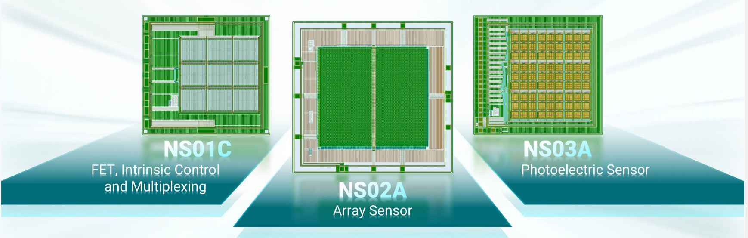
TECHNOLOGY
Semiconductor DNA

Slide 6
TECHNOLOGY
Semiconductor DNA
Novascope’s BioIC Platform: Robustness, Scalability and Cost Efficiency
NS01C: FET-Based Biosensing with Intrinsic Control & Multiplexing
NS01C is our field-effect transistor (FET) biosensing architecture designed specifically for surface-charge detection of an assay with up to eight target molecules. When a target analyte binds to a probe embedded on the chip surface, it alters the local electric field and converts molecular binding events into measurable electronic signals in real time.
All our products currently in the pipeline are built on NS01C.
NS02A: Array Sensor Architecture for High-Throughput Detection
NS02A expands the NovaChip platform into a high-density array configuration, enabling scalable multiplexing and quantitative analysis across large biomarker panels. The NS02A architecture is particularly suited for pathogen panels and antimicrobial resistance (AMR) profiling, where simultaneous interrogation of multiple genetic markers is essential for timely clinical decision-making.
NS03A: Photoelectric Sensor for Hybrid Detection Modalities
NS03A introduces a complementary photoelectric sensing module to support hybrid detection strategies. While Novascope’s core platform leverages electronic charge redistribution, NS03A takes a step further to enable optical-electronic integration where fluorescence or photonic signals can enhance assay flexibility.

Slide 7
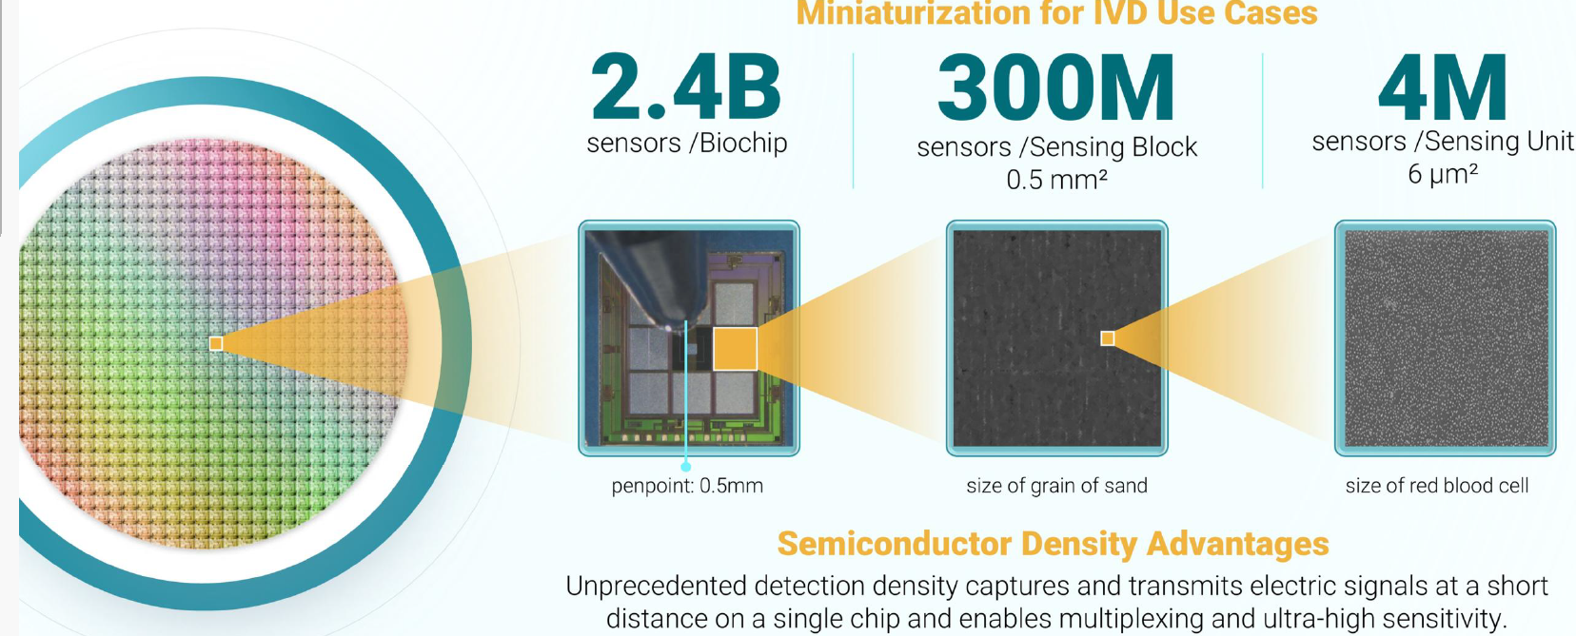
TECHNOLOGY
Semiconductor DNA
Billions of Probe Sensors Packed into One Biochip

Slide 8
TECHNOLOGY
Full-Stack Biochemstry
Programmable, Scalable and Vertically Integrated Biochemistry
Biochemistry Built into Silicon
NovaBIO™
NovaBIO is our microfluidics-based, fast-tracked sample and buffer system designed to streamline sample preparation and stabilize complex biological inputs. By optimizing fluid dynamics at the microscale, NovaBIO ensures controlled analyte transport, efficient reaction kinetics, and minimized sample loss.
This engineered buffer ecosystem improves reproducibility and reduces turnaround time—critical for time-sensitive conditions such as sepsis. It forms the biochemical foundation that allows our biochips to operate with precision under real-world clinical conditions.
NovaLINK™
Patented Surface Chemistry & Proprietary Reagents
NovaLINK represents our proprietary chemistry platform, where probes are embedded directly within the engineered surface coating of the NovaChip. Unlike conventional assays that rely on secondary labeling or optical amplification, NovaLINK integrates specificity at the material level.
Our patented surface treatment technologies and embedded bioprobes enable stable high-affinity binding while preserving electrical sensitivity before and after binding. Our chemistry is not added on—but built within.

Slide 9
ABOUT US
Full-Stack Biochemstry
High-Purity Antibodies: A Strategic Asset Engineered for Precision
High-Purty Antibodies: a Strategic Asset Essential for Novascope BioICs
At Novascope, our high-purity antibodies were born out of necessity. Off-the-shelf antibodies often lack the exact chain composition or the purity required for our ultra-sensitive biochips to deliver reliable, reproducible results. To meet the demanding specifications of molecular-level detection, we designed and manufactured our own proprietary antibodies as bioprobes—tailored to perform with exceptional specificity and stability.
VHH antibodies — also known as nanobodies — expressed in E. coli.
VHH antibodies are single-domain antibody fragments derived from camelid heavy-chain IgG (immunoglobulins). Their compact structure (~15 kDa, compared to ~150 kDa for conventional IgG) confers exceptional advantages for surface-based biosensing: superior thermal and chemical stability, deeper epitope access, and more uniform surface orientation when immobilized on a chip coating.
IgG monoclonal antibodies (mAbs)
Our IgG monoclonal antibodies (mAbs) are produced using Chinese hamster ovary (CHO) cell expression systems — the gold standard for therapeutic-grade biologics manufacturing. This production platform ensures high yield, batch-to-batch consistency, and compatibility with stringent clinical validation standards.

Slide 10
ABOUT US
Full-Stack Biochemstry
High-Purity Antibodies: Ready for Monetization
For sale
Ready to commercialized products
As both a core enabler of our BioIC platform and a standalone revenue-generating asset, our antibodies exemplify the intersection of biotech innovation, precision engineering, and strategic intellectual property.

Slide 11
ABOUT US
Full-Stack Biochemstry
Data-Driven Probe Design
Nosocomial Pathogen Strain Bank & WGS (Whole-Genome Sequencing) Library
To power rapid assay development of our bio-portfolio of infectious diseases, we are building a pathogen strain bank in collaboration with Chang Gung Memorial Hospital. This resource includes 700+ bacterial isolates accumulated over nearly 30 years. Out of these, 206 isolates are ready for whole-genome sequencing (WGS) and 494 isolates have been prepared for DNA extraction.
This curated strain repository enables rapid bioprobe design, antimicrobial resistance (AMR) panel development and optimization, and real-world validation. Our WGS library currently under construction promises to transform clinical isolates into actionable genomic intelligence on the NovaChip platform.

Slide 12
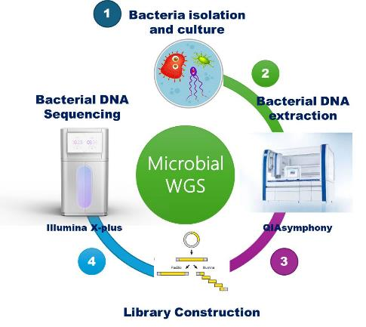
ABOUT US
WGS (Whole-Genome Sequencing) Library Construction
Full-Stack Biochemstry

Slide 13
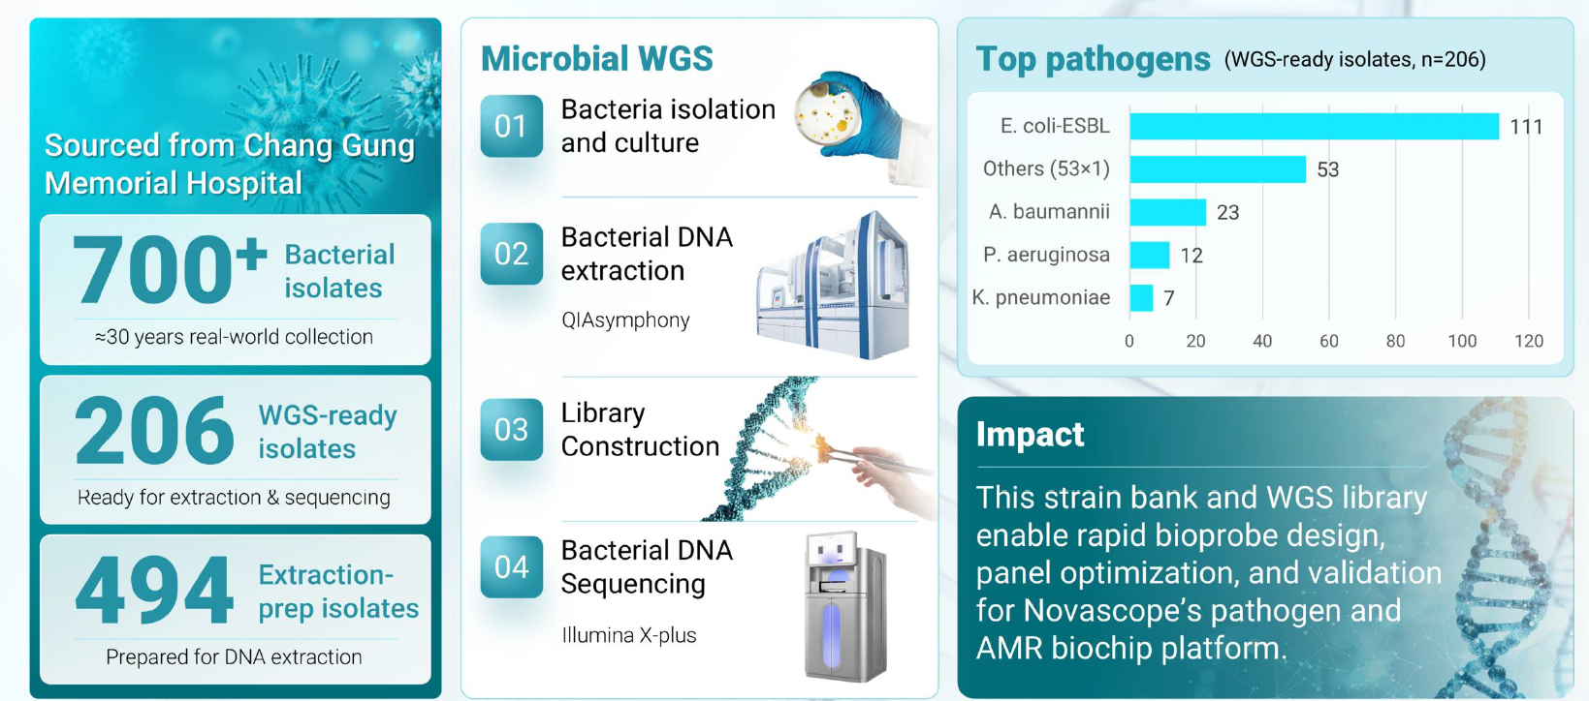
ABOUT US
Full-Stack Biochemstry
Data-Driven Probe Design

Slide 14
TECHNOLOGY
The BioFET Advantage
From Probes to Processors
From Silicon to Signals: A Simple and Seamless Diagnostic Workflow
Novascope’s BioIC platform is engineered for simplicity. Each step—from semiconductor fabrication to real-time results—is designed to minimize complexity while maximizing performance. The workflow is intuitive, scalable, and built on semiconductor-grade precision.
1. Bare Chip: Precision Fabricated. Fully Validated.
Every NovaChip begins at UMC in Taiwan, a world-class CMOS foundry to which we are a direct customer. Once fabricated, each wafer undergoes rigorous electrical testing and quality verification by Novascope.
2. Functional Biochip: Proprietary Bioprobe Design and Surface Coating.
Through our proprietary surface chemistry platform, bioprobes are embedded directly into the engineered chip surface coating. This transforms a precision silicon die into a functional biochip.
3. Apply Sample: Sample in, Simple and Direct.
Using our optimized microfluidic and buffer system, the sample is applied directly onto the chip. Any molecule that carries an electric charge—DNA, RNA, proteins, or other analytes—can be detected at a low concentration, provided a specific binding event induced by the bioprobe occurs.

Slide 15
TECHNOLOGY
The BioFET Advantage
From Probes to Processors
4. Bio-Sensing: Direct Electronic Detection of Molecules at the Silicon Interface.
When a target molecule binds to its bioprobe, it alters the electric charge distribution at the chip surface. This change is immediately detected by the underlying FET sensor architecture.
5. Signal Reading: Real-Time Results, Digitally Native
The electrical signal is digitized directly on-chip and transmitted for clinical interpretation. Ignoring the sample preparation process, test results are generated in real time, enabling rapid clinical decision-making.
6. AI-Powered Analytics: From Detection to Decision Support (Future Expansion)
Looking ahead, Novascope plans to introduce AI-powered analytics as a value-added layer. By leveraging aggregated signal data, pathogen strain intelligence, and clinical context, advanced algorithms will support:

Slide 16

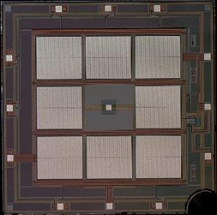




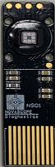
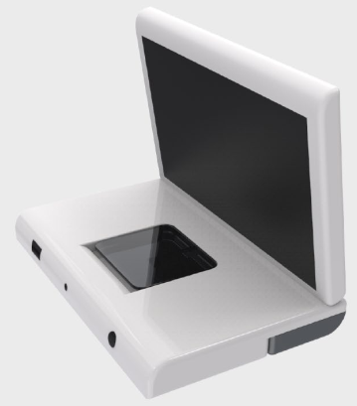
NOVASCOPE Extended-Gate FET (Field Effect Transistor): From Probes to Processors
AI-powered analytics as value added service
I
V
Bare chip
Functional biochip
Apply Sample
Bio-Sensing
Signal Reading
current
Proprietary bioprobe coating
Any molecule that carries electric charges
FET detects change of electricity discharge
Real-time test results
Biochip Design and Production
Automated Process

Slide 17
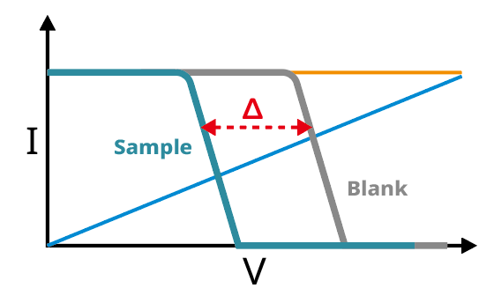
TECHNOLOGY
The BioFET Advantage
From Probes to Processors
From Silicon to Signals
The Novascope platform detects target molecules by reading the information on the change of direct electrical signals on silicon caused by the binding of the target molecule and the bioprobe.
The molecular interaction provides the signal required for both qualitative (shift of the electric curve) and quantitative results (magnitude of the shift).

Slide 18
TECHNOLOGY
Intellectual Property
From Silicon Layout to Surface Chemistry
Full-stack Intellectual Property Ownership
Novascope maintains full ownership of its intellectual property, with 40+ patents filed and pending covering chip architecture, detection circuitry, chemistry integration, and system design.
100% Silicon IP Designed from First Principles
We are the first-in-class bio-fabless company that applies the semiconductor chip design paradigm to the domain of biochemistry and diagnostics. However, we are different from many IC design houses that rely heavily on standard IP blocks and automated EDA (Electric Design Automation) tool flows. Our core sensing architecture, layout strategy, and signal chain design are proprietary. By maintaining direct control over device physics modeling, analog front-end optimization, and layout engineering, we preserve both performance differentiation and economic value capture.

Slide 19
TECHNOLOGY
Intellectual Property
From Chip to Chemistry: Fully Protected
Intellectual Property Strategy: Layered Protection. Long-Term Advantage.
Innovation at Novascope is protected with the same rigor used to design it. We have filed more than 40 patents, spanning chip architecture, sensing circuitry, surface chemistry, reagent systems, and integrated diagnostic platforms.
We have developed a layered IP protection strategy as follows:
Patent Protection: Securing core inventions and platform-level claims
Trade Secrets: Protecting implementation details, process know-how, and optimization methods
Operational Safeguards: Controlled knowledge access and disciplined documentation management

Slide 20
TECHNOLOGY
Intellectual Property
An End-to-End Platform
A Walled Garden Built on Intellectual Property.
We are building a vertically integrated BioIC ecosystem, from bioprobes, biochips, test result readers to diagnostic devices. From chip architecture and surface chemistry to assay development, firmware, analytics, and clinical validation, every layer of the stack is designed to work seamlessly together and safeguarded with a layered IP protection strategy.
This end-to-end integration allows us to control performance, quality, and user experience in the same way category-defining companies have done in other technology industries.

